Slide 1
Lead Scoring Case Study
By Tharun Thodimi

Slide 2
Problem Statement
X Education sells online courses to industry professionals. On any given day, many professionals who are interested in the courses land on their website and browse for courses.
The company markets its courses on several websites and search engines like Google. Once these people land on the website, they might browse the courses or fill up a form for the course or watch some videos. When these people fill up a form providing their email address or phone number, they are classified to be a lead. Now, X Education gets a lot of leads, but its lead conversion rate is very poor
To make this process more efficient, the company wishes to identify the most potential leads, also known as ‘Hot Leads’. If they successfully identify this set of leads, the lead conversion rate should go up as the sales team will now be focusing more on communicating with the potential leads rather than making calls to everyone.

Slide 3
High Level Approach
Step 1
Step 2
Step 3
Data cleaning
Imputing missing values and removing columns having high % of null values (30%)
Removing features with zero variance
Selecting features which were filled by leads rather than created by employee
Feature Encoding and Scaling
Removing statistical outliers from numerical variables
One hot key encoding the categorical variables
Scaling the numerical variables using StandardScaler
Running models and validation
Logistic regression is used to determine the conversion probability
RFE is used to eliminate statistically insignificant / irrelevant features
Validating the model on test data and examine the final variables

Slide 4


Results
The following variables can be used to identify the hot leads (ones which can be converted)
Last Notable Activity
Lead Origin
Total Visits, Total Time spent on Website and Page Views per Visit
Lead’s occupation status
Last Notable Activity
Based on log of student’s last activity, various strategies can be deployed. According to model, conversion was more probable if student had a phone conversation with employee
Lead Origin
The conversion is more probable if the leads have filled the form on website. These leads were convinced right from the beginning with the information about course from website. They willingly filled the form so as to get in touch for more information. Targeting these leads will be fruitful

Slide 5


Results
The following variables can be used to identify the hot leads (ones which can be converted)
Last Notable Activity
Lead Origin
Total Visits, Total Time spent on Website and Page Views per Visit
Lead’s occupation status
Total Visits, Total Time spent on Website and Page Views per Visit
High digital activity (page views and time spent) indicates high chances of conversion. It shows that students are trying to get more information about the course so as to take a decision to opt or not. These leads should be called often to aid them with any questions they might have
Lead’s Occupation Status
The profession of the lead is a very good determinant of conversion. The working professional have more tendency to opt for the courses over the unemployed leads.

Slide 6
80%
Model’s Recall on the Test Dataset
Out of Actual Total Converted Cases, 80% were correctly predicted by the model

Slide 7
Approach Deepdive

Slide 8
Data Cleaning
There are 37 columns in the data set and contains information about 9,240 leads. However, multiple columns had null values (converted select category to null) .The following steps were taken to clean the dataset
Step 2
Step 1
Step 2
Step 3
Removing the variables with more than 30% null values
Variables like Tags, Lead Quality, Profile score etc were inputs by the employees. Using them as features in model would not be correct because it would get dependent on variables which can be controlled manually
Imputing values for variables with 2% - 30% null values
Categorical variables are imputed with the most occurring observation and for numerical variables the null values are replaced with median observation (50th percentile)
Removing variables with zero variances
Variables like Country, Do Not Call, Which course matters the most etc - were dropped as they had zero variances. Like for eg - Country column had more than 97% response as India. These variables would not help in prediction as they would not vary much in respect to converted flag

Slide 9
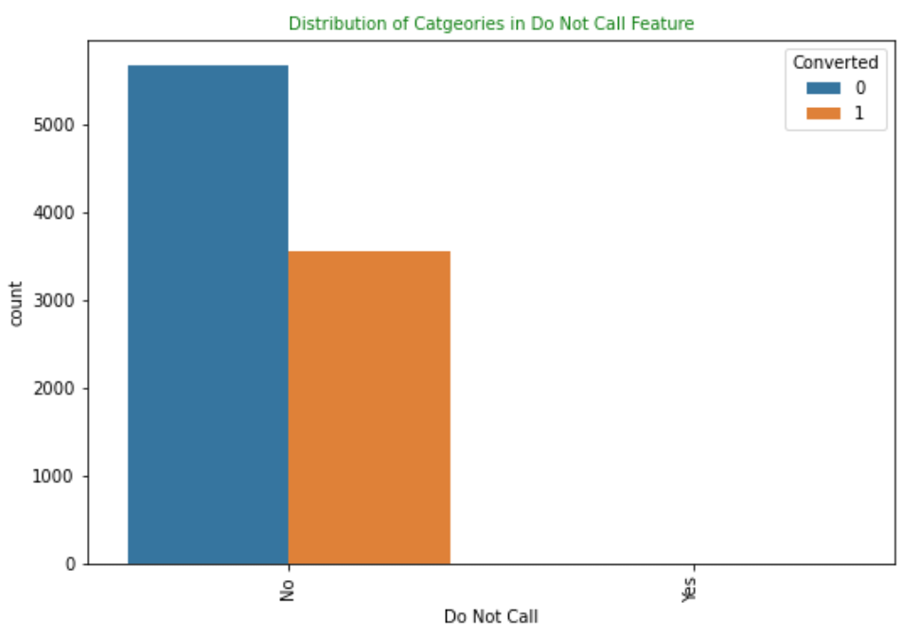
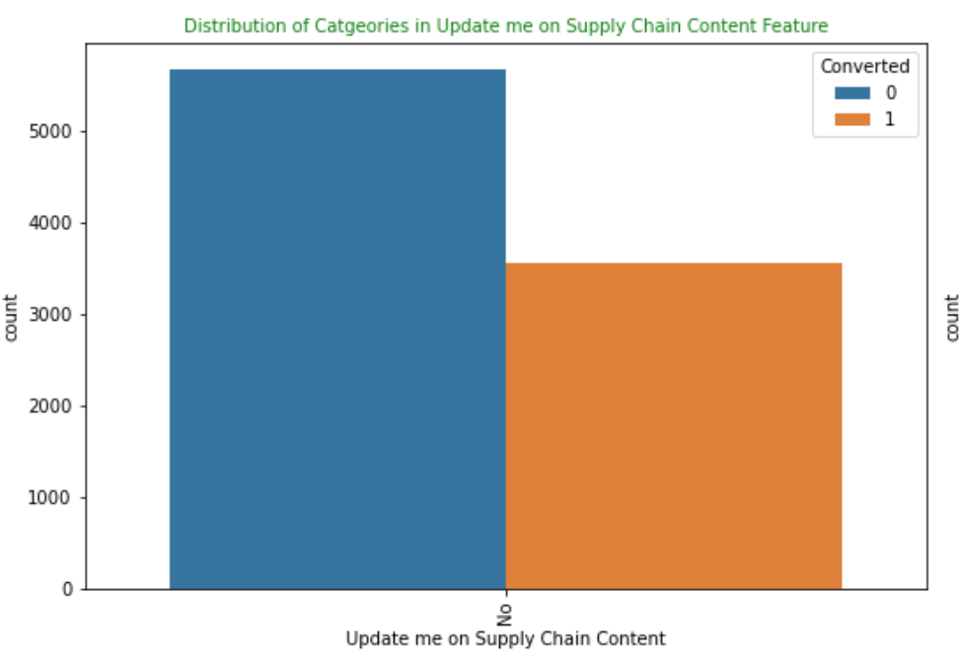
Examples of zero variance columns
Step 2
Step 3

Slide 10
Feature Scaling, Encoding and Selection
Once the data is cleaned and there no null values present. The next step is to scale the numerical variables, one hot key encoding of categorical variables and use RFE to get top 15 statistically significant variables
Step 2
Step 1
Step 2
Step 3
Feature Scaling
The three numerical variables are scaled such that the values lie between 0 & 1. This is done in order to ensure that no variable dominates due to individual scales
Feature Encoding
Using one hot key encoding, (N-1) dummy variables are created for all the remaining categorical variables. Where N - number of unique entries within each categorical variable
RFE to obtain top 15 variables
Post encoding there are 51 variables in the dataset. Not all would be statistically significant to obtain the conversion probability. RFE (Recursion Feature Elimination) technique is used to rank the variables and based on input returns the number of predictor variables. The 15 variables are ran in the Logistic model.

Slide 11
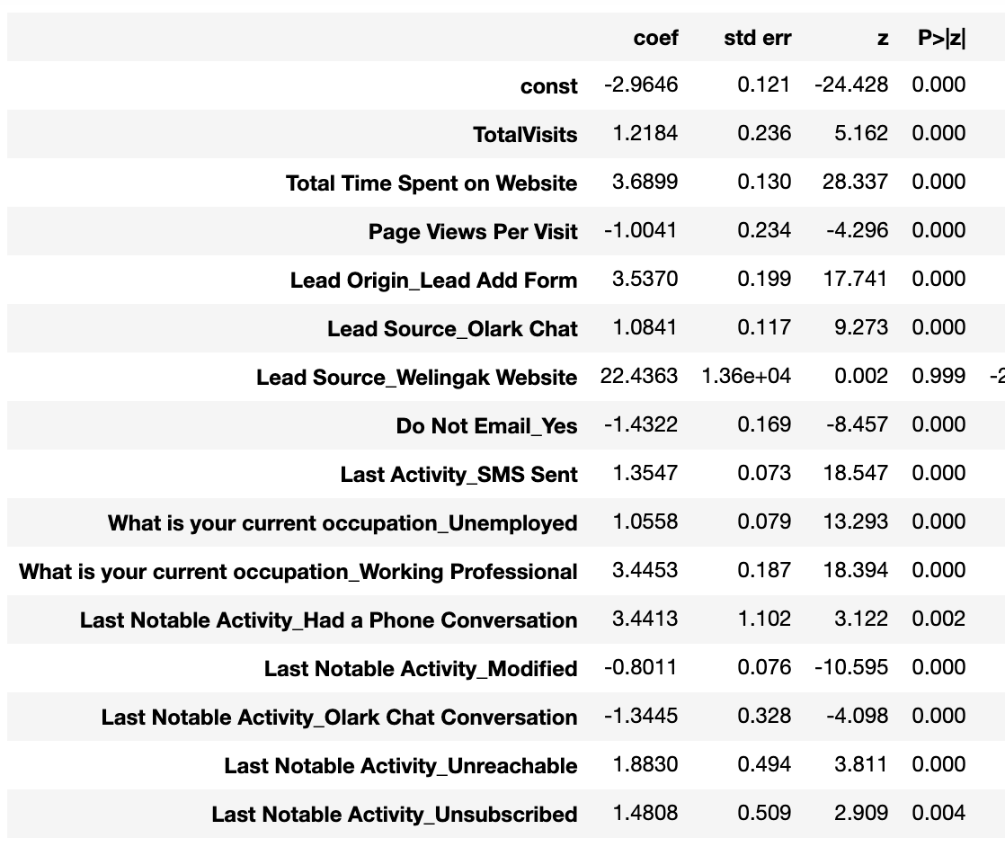
Logistic Regression Model 1 Results
The variable has p values greater than 0.05 which shows that it is statistically insignificant and should be removed from model

Slide 12
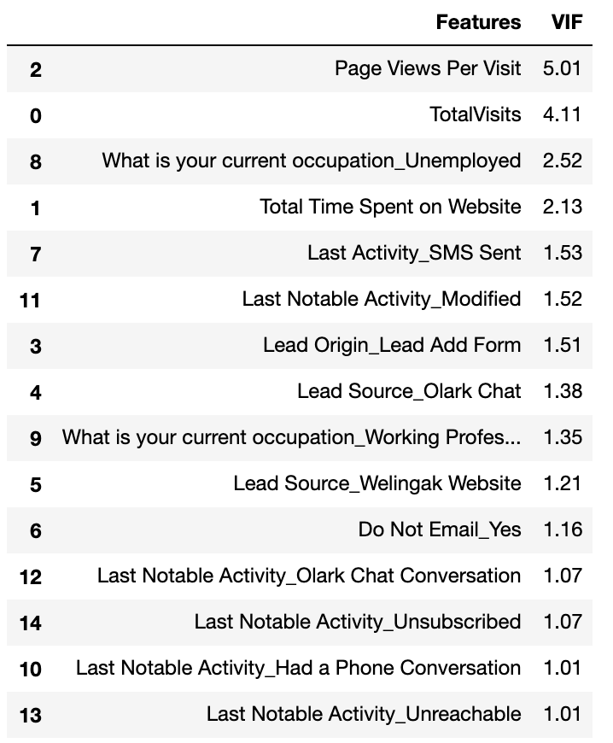
Logistic Regression Model 1 VIF Results
Checked the VIF values as well to check if there is no multicollinearity within the data. Since for all variables the VIF is < 10 - there is no multicollinearity

Slide 13
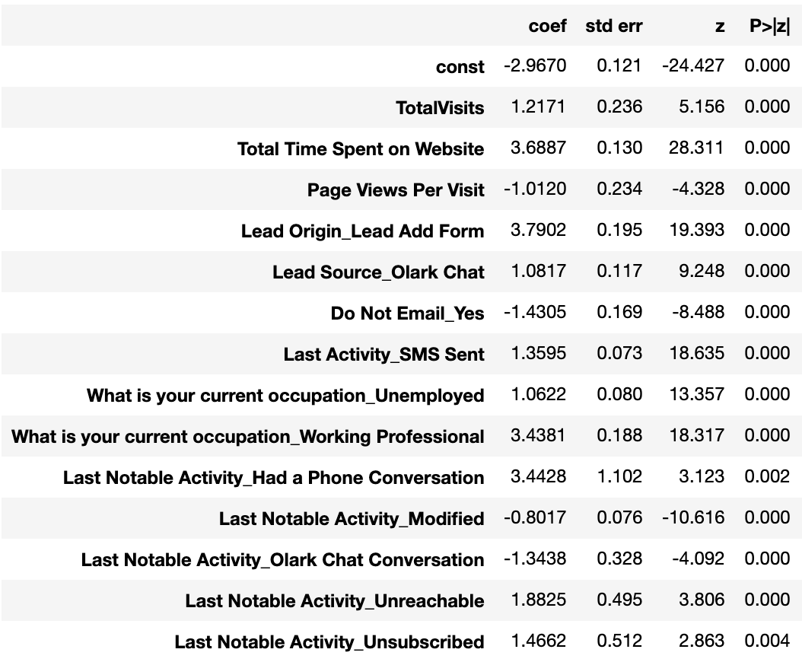
Logistic Regression Model 2 Results (Post removing insignificant variable)
All the variables have p value less than 0.05 and this model can be used for predicting the conversion within training data set

Slide 14
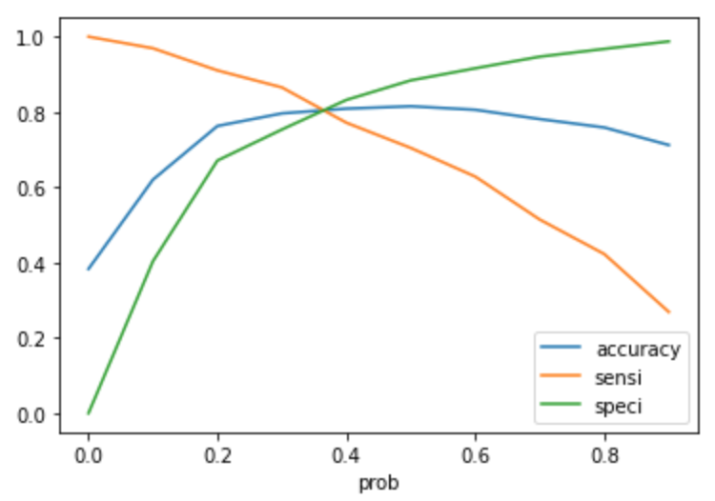
Optimum probability threshold value
Logistic regression gives the probability based on the input variables. Sensitivity - Specificity curves are used to identify the optimum probability threshold. The threshold helps in determining if the lead will get converted or not based on the probability calculated by model.
The curve is plotted for various threshold and the place where they intersect becomes the optimum point. In this case the optimum value is 0.35
Step 2

Slide 15
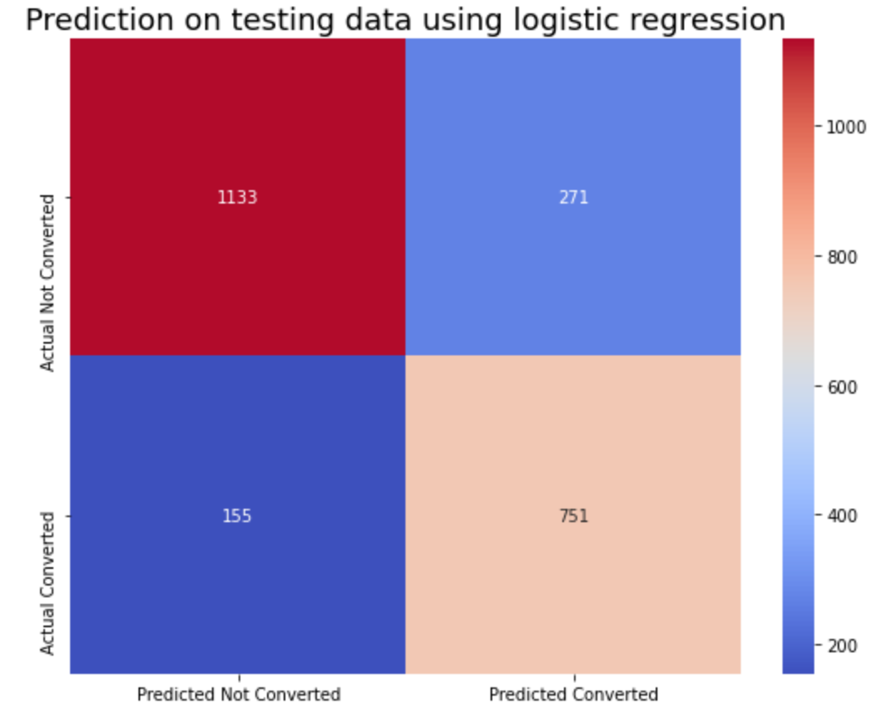
Statistical Results
Training Data
Accuracy 81%
Recall 81%
Testing Data
Accuracy 82%
Recall 83%
The accuracy and recall is similar in both training and testing data set
The lead score has been calculated by multiplying the conversion probability by 100 for the employees to help target hot leads
Step 2

Slide 16

Thanks!

